Slide 1
IOCL BOTTLING PLANT, PATTIKALAN, HAZOP

Slide 2
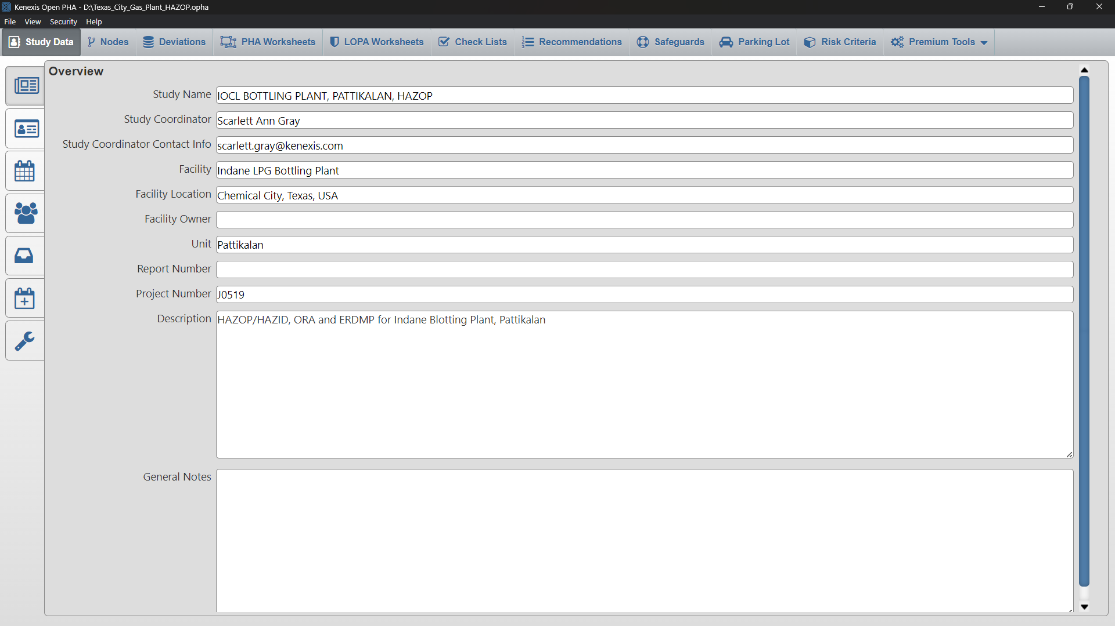
Overview

Slide 3
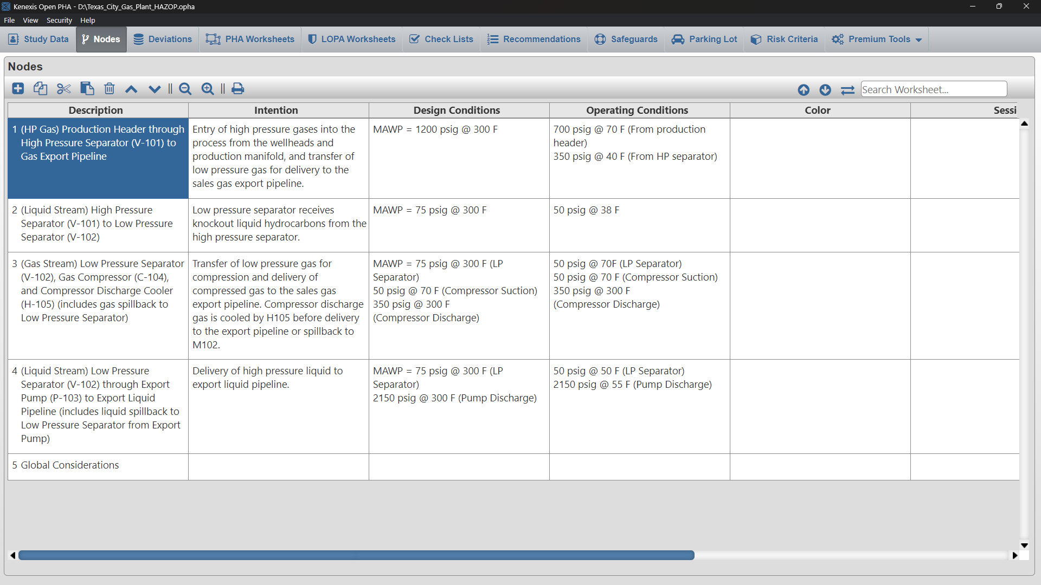
Nodes

Slide 4
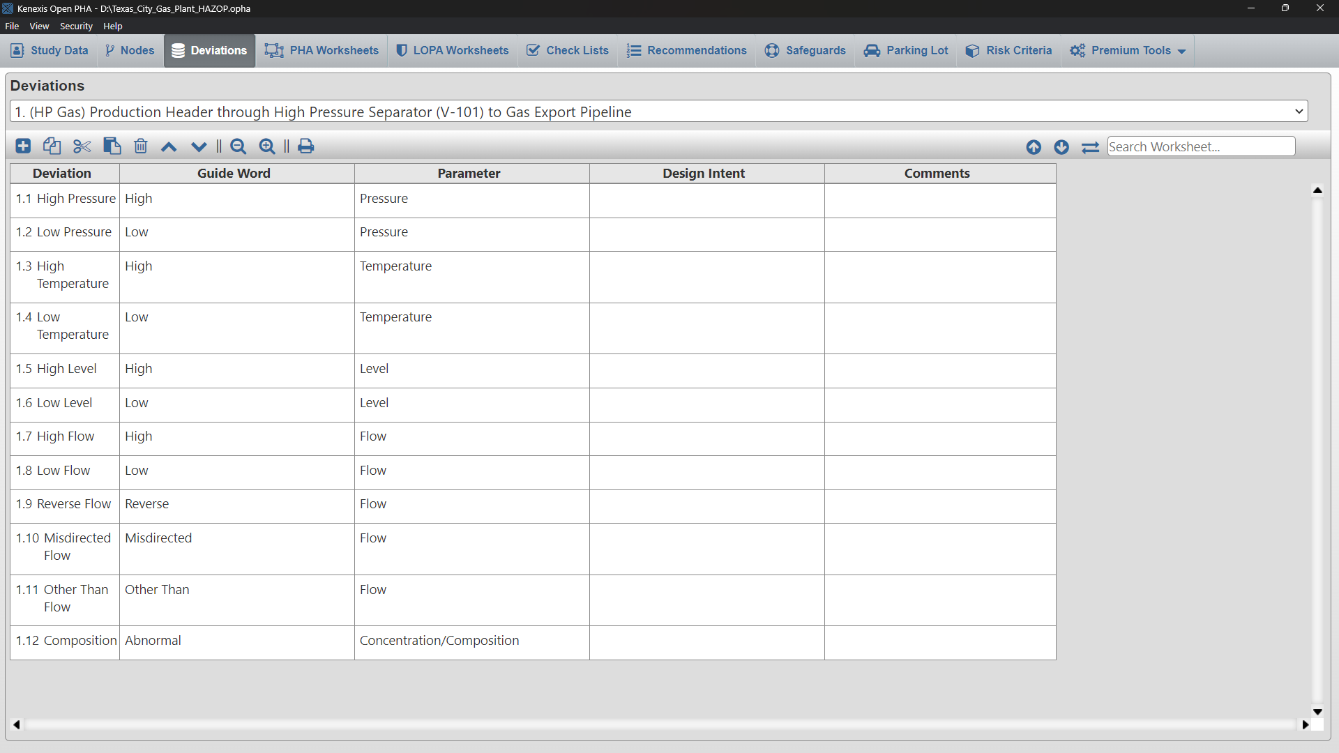
Deviations

Slide 5
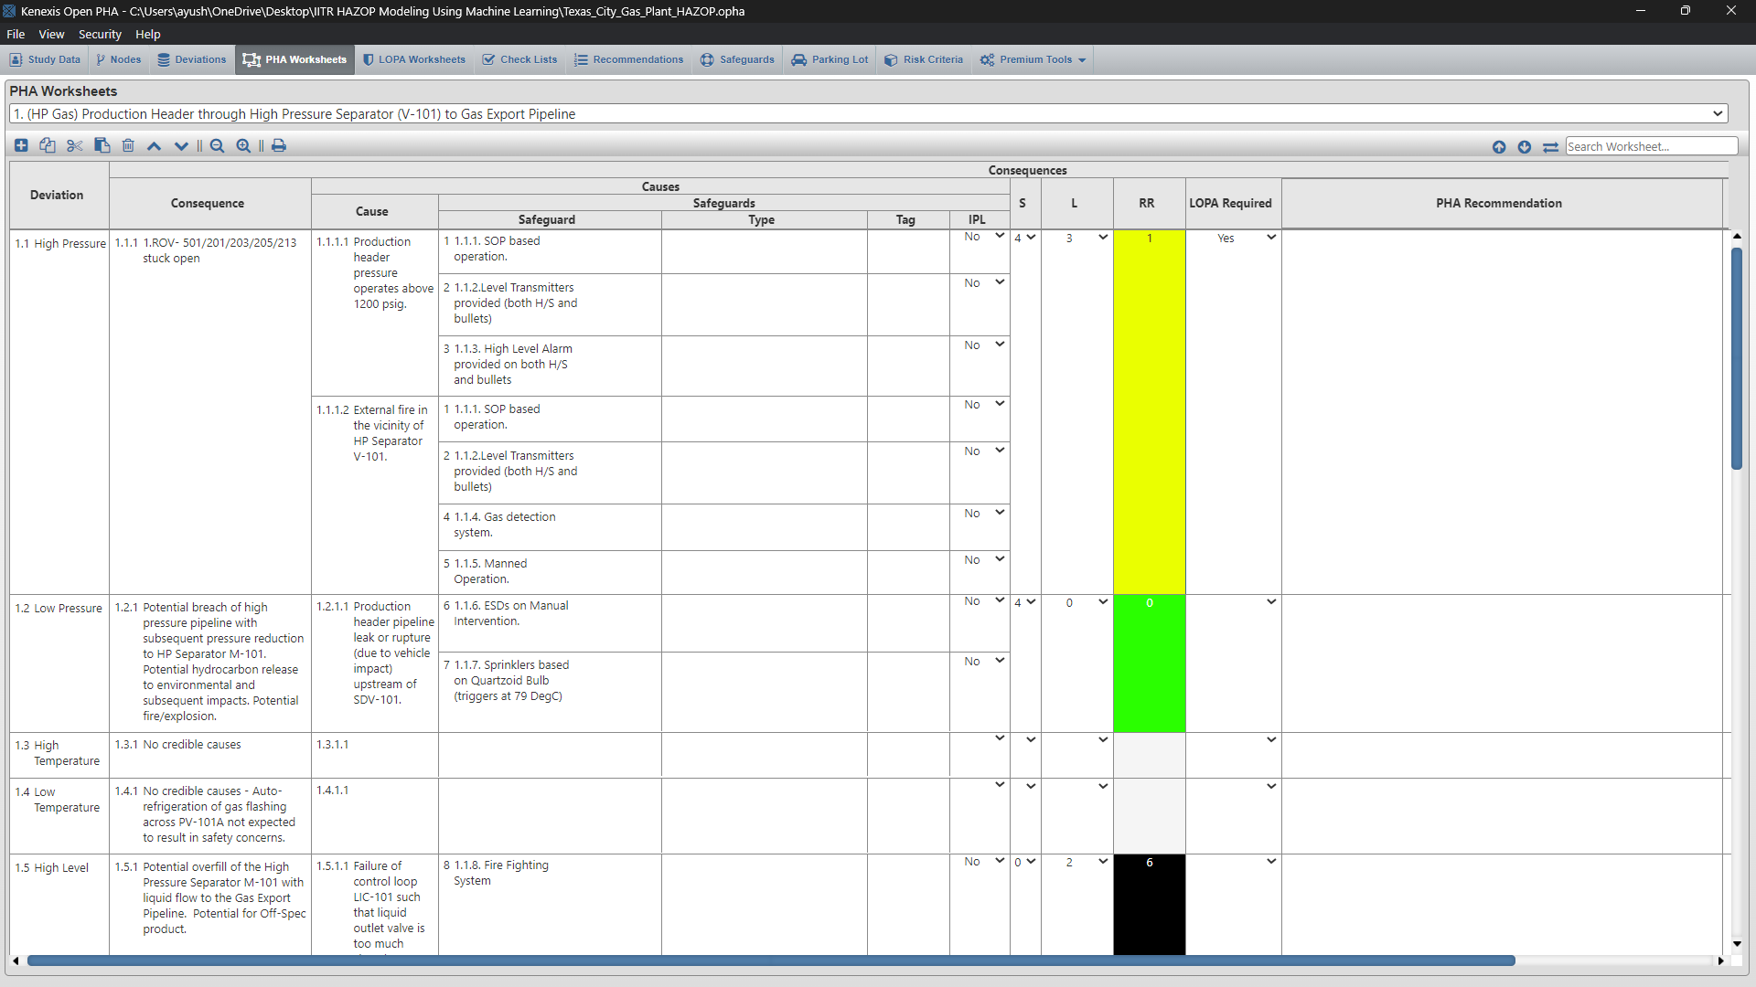
PHA Worksheet

Slide 6
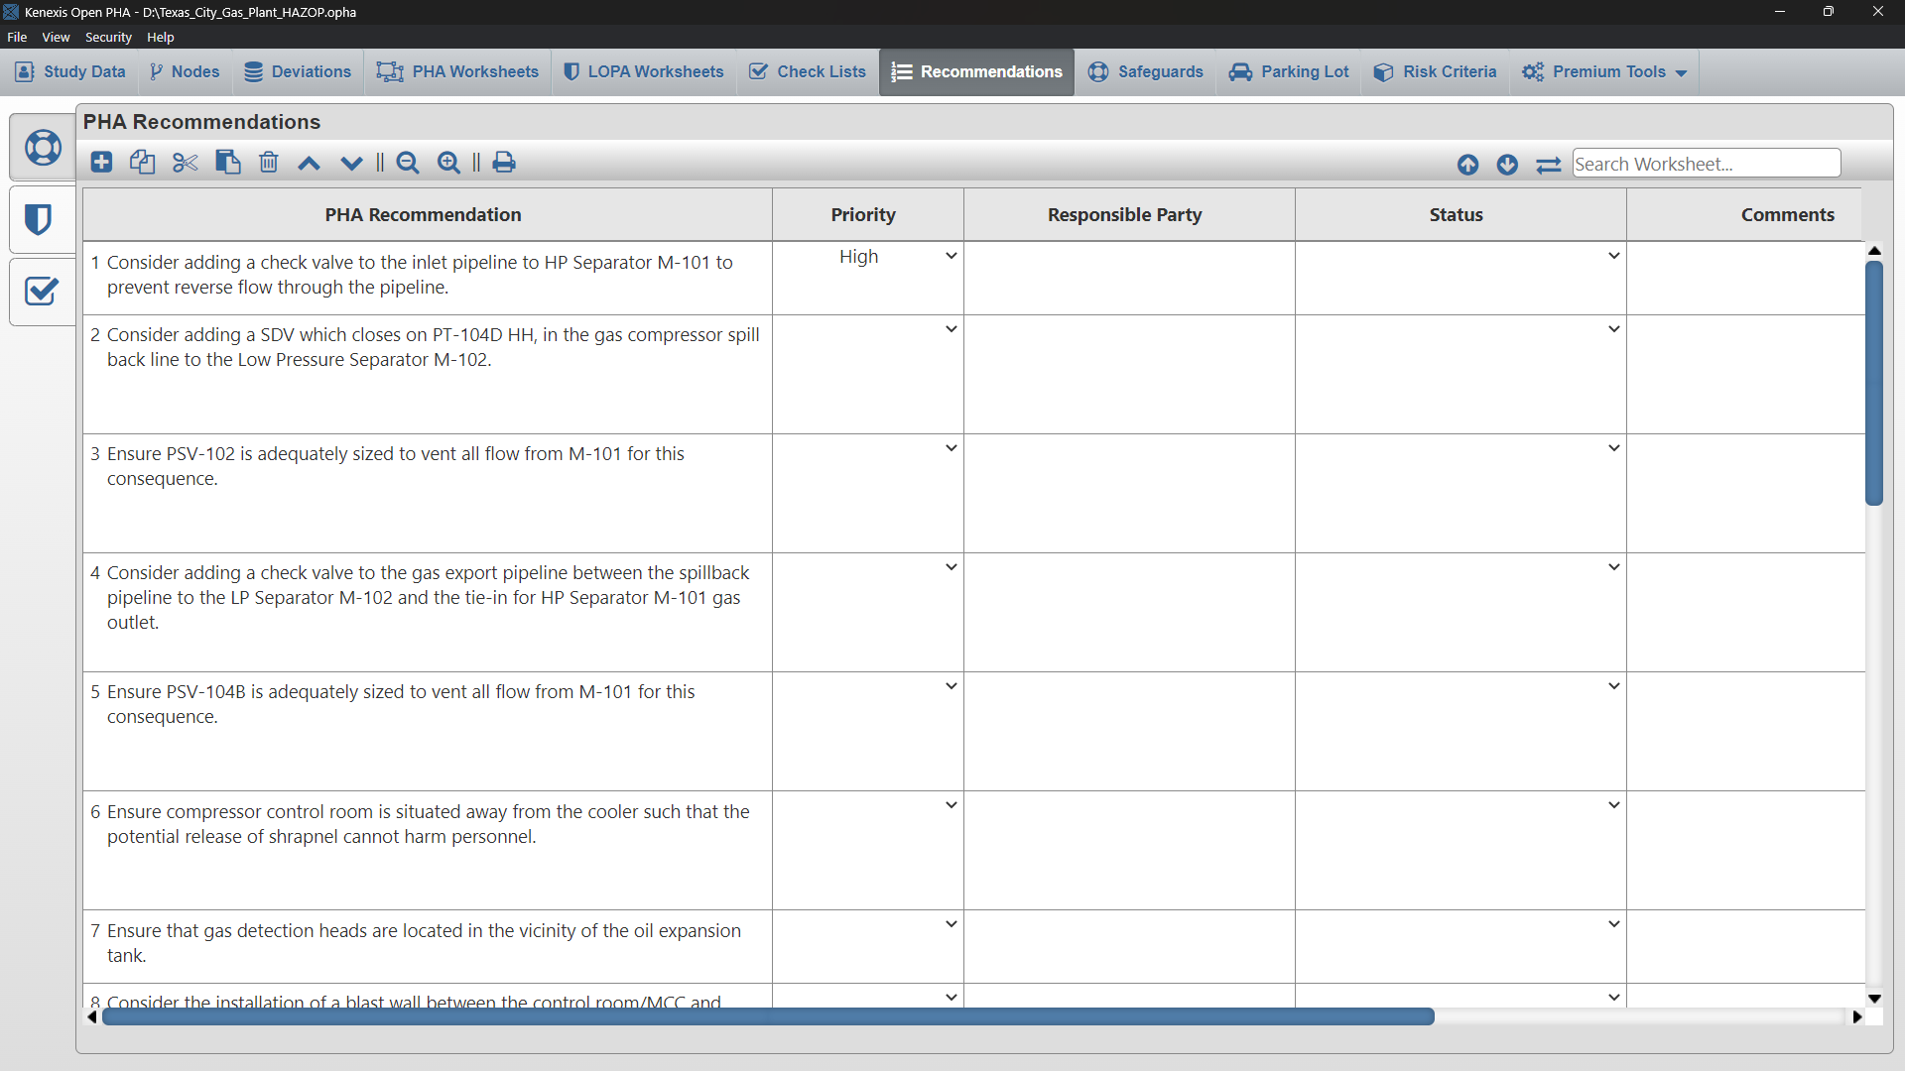
Recommendations

Slide 7
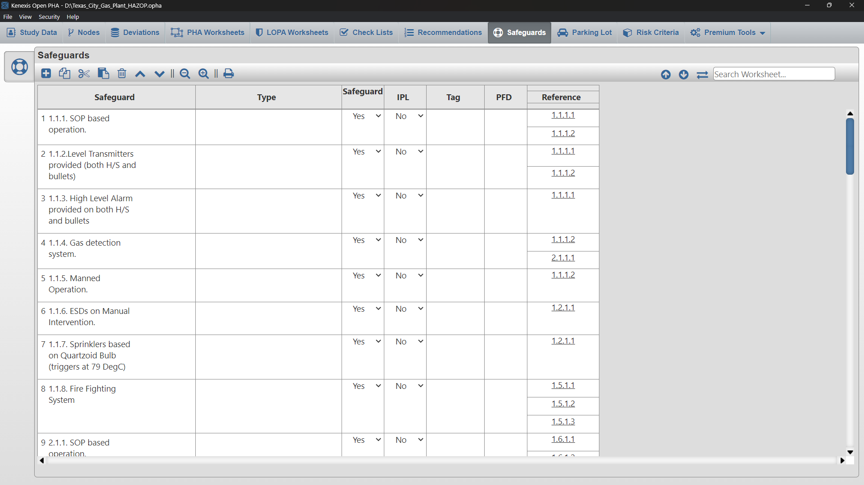
Safegaurds

Slide 8
Steps of Risk Assessment
Identify the hazards
Identify the people who might be harmed and how
Evaluate the risks and decide on precautions
Record the significant findings & implement them
Review and update as necessary
RISK= Probability x Serevity
Likelihood-> Chances of occurence (Accident)
Consequnces->Results of Accident
Green- Very less Risk
Yellow- Suitable for work
Red- High Risk

Slide 9
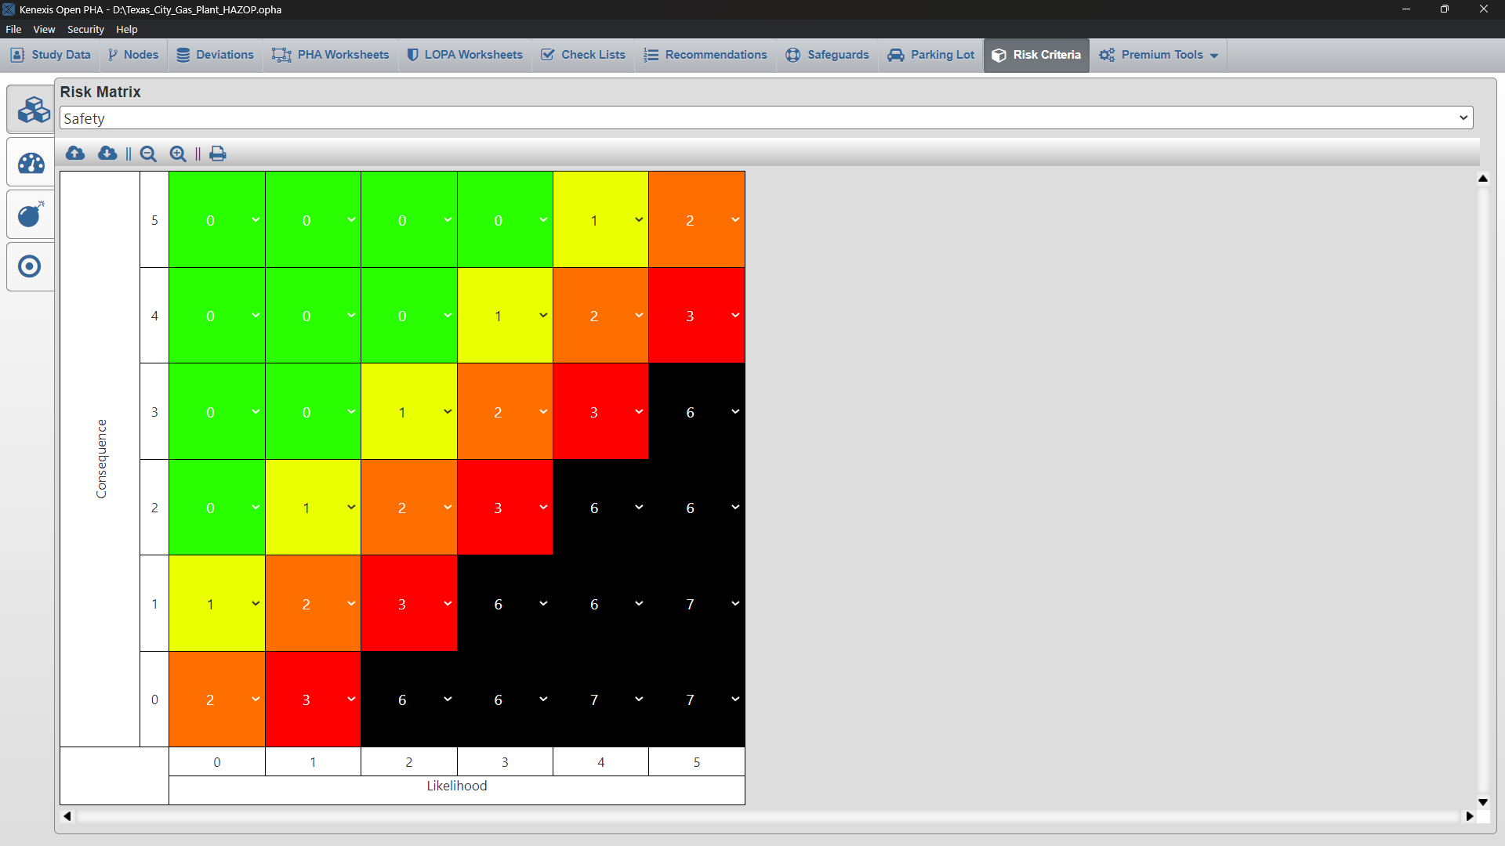
Risk Matrix

Slide 10
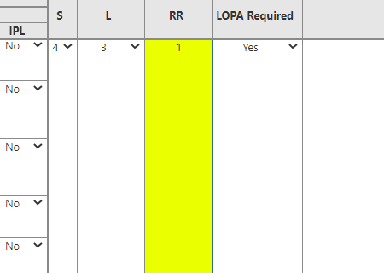
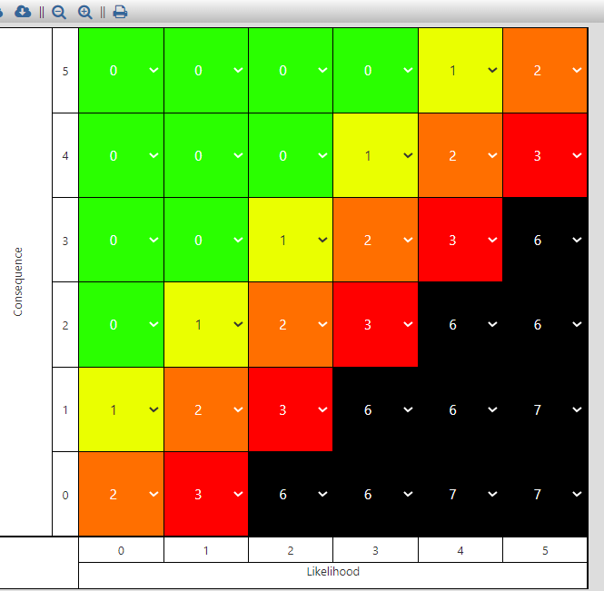
Node1-Deviation 1.1

Slide 11
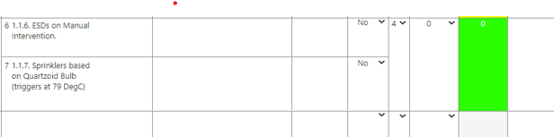
Node1-Deviation 1.2

Slide 12
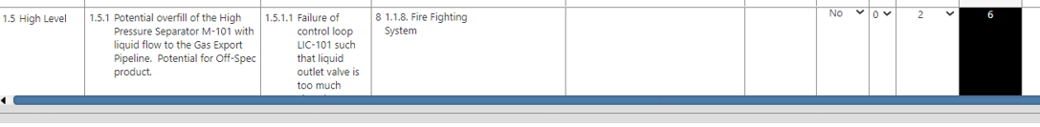

Slide 13
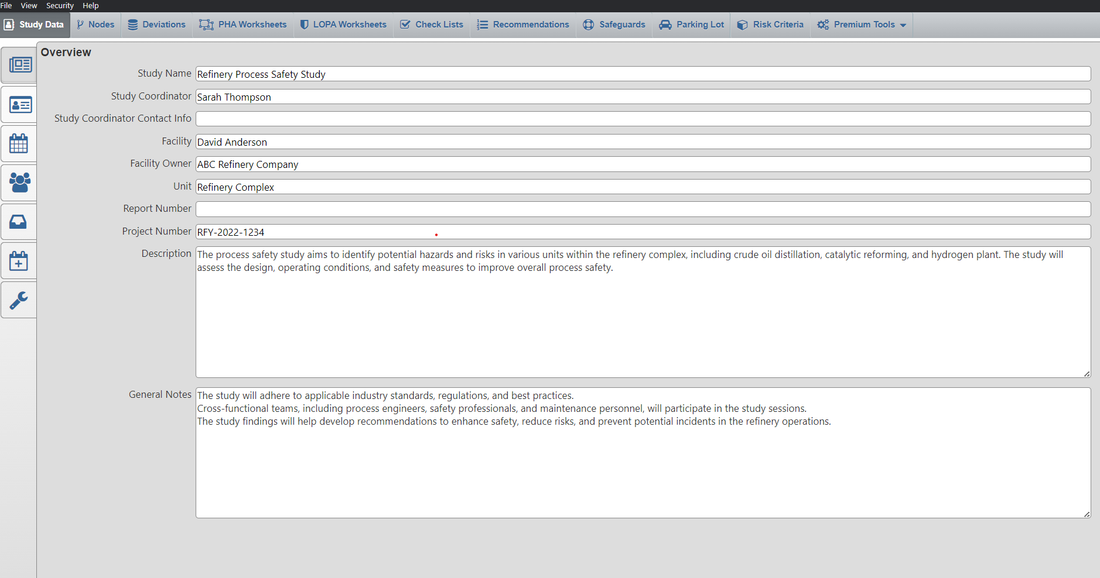
HAZOP Report-Refinery

Slide 14
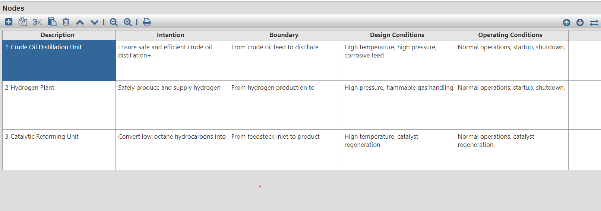
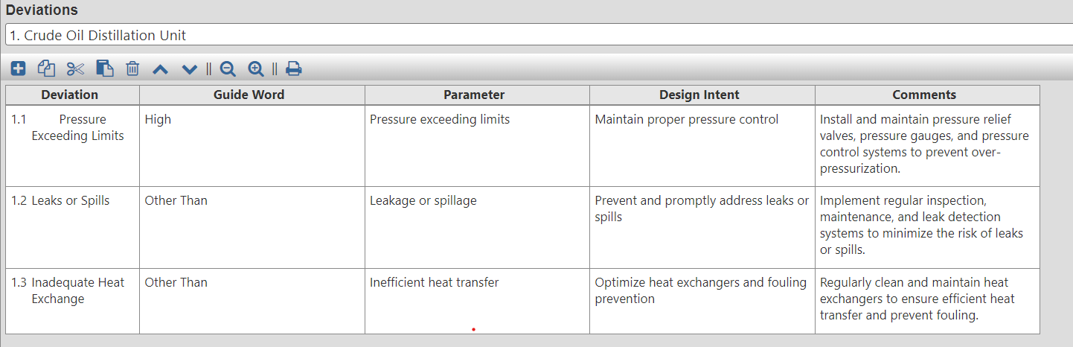

Slide 15
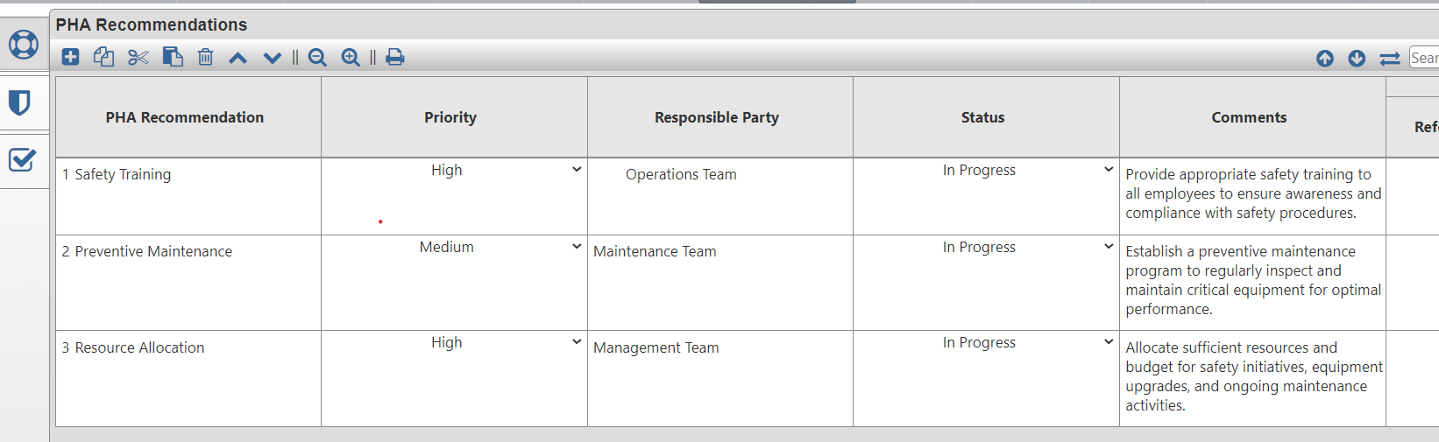
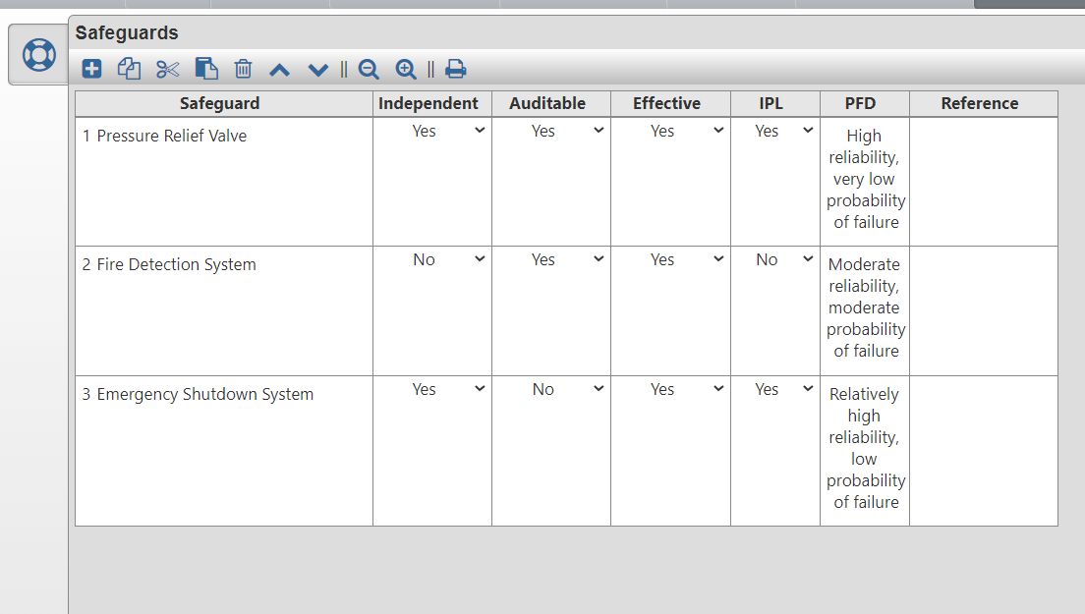

Slide 16
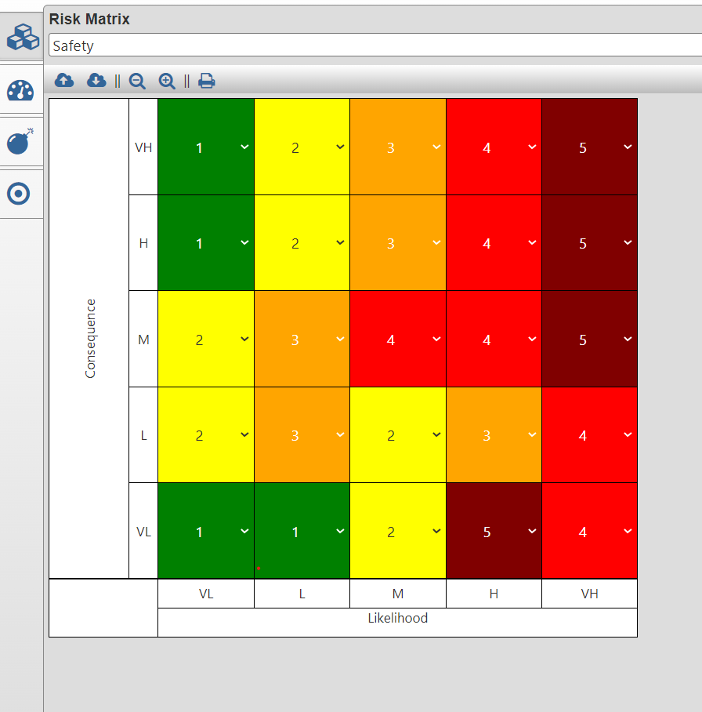
Risk Matrix
Region of Intermediate Risk
Region of Very High Risk
Region of Very Low Risk

Slide 17
ML Code Form
import pandas as pd
import numpy as np
# Hypothetical deviations with risk criteria
deviations_data = {
'Node': ['Crude Oil Distillation Unit', 'Hydrogen Plant','Catalytic Reforming Unit'],
'Deviation': [' Pressure Exceeding Limits', 'Leaks or Spills','Inadequate Heat Exchange']
'Guide Word': ['High', 'Other Than','Other Than'],
'Parameter': ['Pressure exceeding limits', 'Leakage or spillage','Prevent and promptly address leaks or spills','Optimize heat exchangers and fouling prevention'],
'Design Intent': ['Maintain proper pressure control ', 'React chemicals A and B to form compound X'],
'Cause': ['Failure of temperature control system', 'Blockage in the flow line'],
'Consequence Category': ['Fire/Explosion', 'Quality/Productivity'],
'IPL Requirement': ['Temperature sensor with alarm and automatic shutdown', 'Flow rate monitoring system with interlock'],
'LOPA Requirement': ['Safety interlock and emergency shutdown system', 'Additional flow sensors for redundancy'],
'PHA Recommendation': ['Safety Training', 'Preventive Maintenance','Resource Allocation'],
'Priority': ['High', 'Medium','High'],
'Responsible Party': [' Operations Team', 'Maintenance Team','Management Team'],
'Status': ['Open', 'Open','Open'],
'Comments': ['Provide appropriate safety training to all employees to ensure awareness and compliance with safety procedures.',

Slide 18
'Establish a preventive maintenance program to regularly inspect and maintain critical equipment for optimal performance.','Allocate sufficient resources and budget for safety initiatives, equipment upgrades, and ongoing maintenance activities.
'
'
'],
'Safeguard': ['Pressure Relief Valve', 'Fire Detection System','Emergency Shutdown System'],
'Risk Criteria': ['Tolerable if frequency < 1/year', 'Tolerable if production loss < 5%'],
}
# Create a DataFrame from the deviations data
deviations_df = pd.DataFrame(deviations_data)
# Risk levels mapping
risk_levels = {
'Low': 1,
'Medium': 3,
'High': 5,
}
# Map consequence severity and likelihood to risk levels
deviations_df['Consequence Severity Level'] = deviations_df['Consequence'].map(risk_levels)
deviations_df['Likelihood Level'] = deviations_df['Priority'].map(risk_levels)

Slide 19
# Generate the risk matrix (original)
risk_matrix_data = {
'Consequence \ Likelihood': ['Insignificant', 'Minor', 'Moderate', 'Major', 'Severe'],
'Level 1': ['Green', 'Green', 'Yellow', 'Brown', 'Red'],
'Level 2': ['Yellow', 'Orange', 'Yellow', 'Orange', 'Red'],
'Level 3': ['Yellow', 'Orange', 'Red', 'Red', 'Brown'],
'Level 4': ['Green', 'Yellow', 'Orange', 'Red', 'Brown'],
'Level 5': ['Green', 'Yellow', 'Orange', 'Red', 'Brown'],
}
# Create a DataFrame for the risk matrix (original)
risk_matrix_df = pd.DataFrame(risk_matrix_data)
# Set the risk levels as index
risk_matrix_df.set_index('Consequence \ Likelihood', inplace=True)
# Add a row and column of zeros to the original risk matrix
zero_row = pd.Series([0] * len(risk_matrix_df.columns), name='Zero')
risk_matrix_df_with_zeros = pd.concat([zero_row, risk_matrix_df], axis=0)
risk_matrix_df_with_zeros = pd.concat([zero_row, risk_matrix_df_with_zeros], axis=1)

Slide 20
# Generate the mirrored risk matrix
upper_triangle = np.triu(risk_matrix_df_with_zeros.values)
mirrored_risk_matrix = np.concatenate((upper_triangle, upper_triangle.T), axis=1)
# Create a DataFrame for the mirrored risk matrix
columns = list(risk_matrix_df_with_zeros.columns)
index = list(risk_matrix_df_with_zeros.index) + list(risk_matrix_df_with_zeros.index)[1:][::-1]
mirrored_risk_matrix_df = pd.DataFrame(mirrored_risk_matrix, columns=columns, index=index)
# Save the DataFrames to Excel files
output_deviations_file = 'hazop_deviations_with_risk_matrix.xlsx'
output_risk_matrix_file = 'hazop_risk_matrix_mirrored.xlsx'
deviations_df.to_excel(output_deviations_file, index=False)
mirrored_risk_matrix_df.to_excel(output_risk_matrix_file)

Slide 21
Thank you

